Slide 2
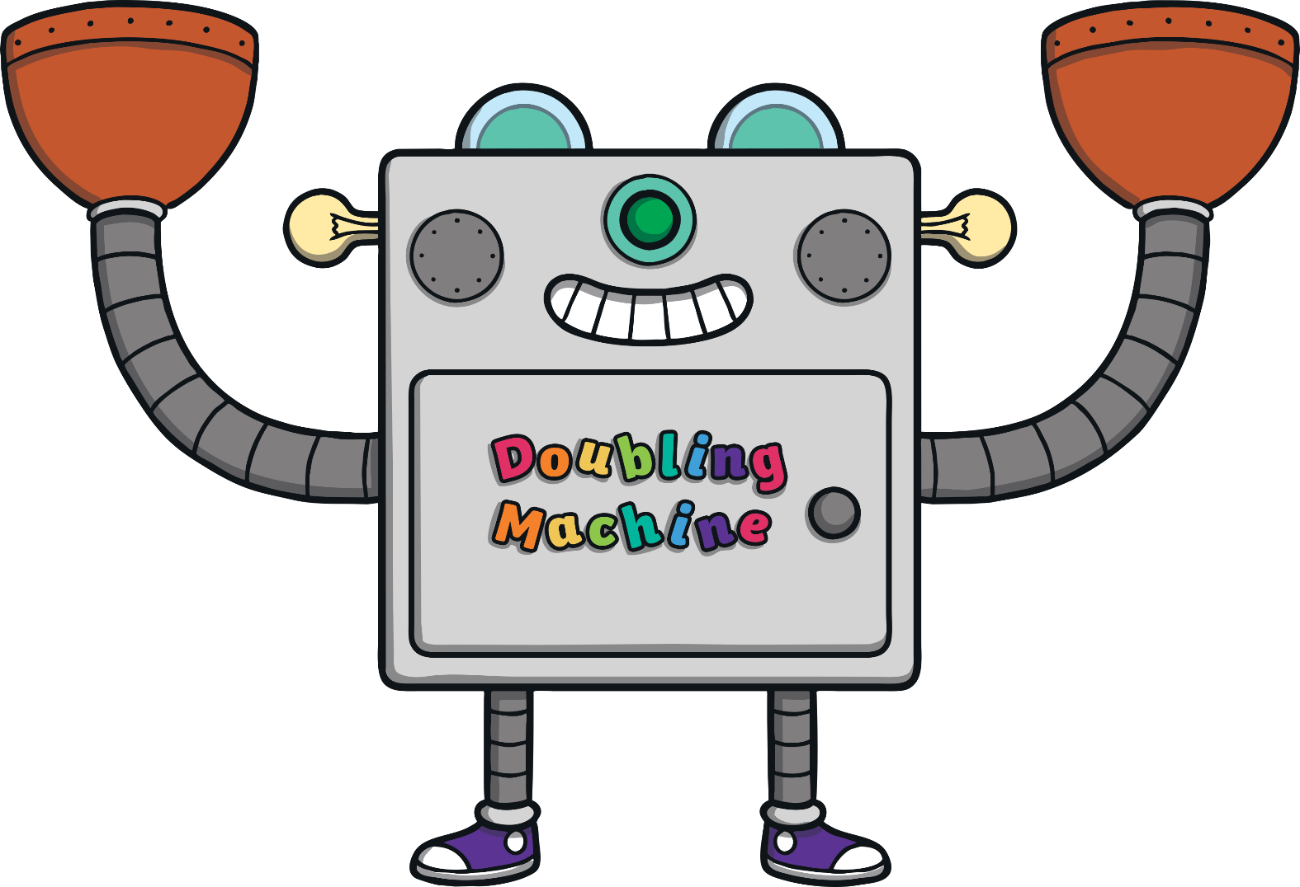
4 + 1 =
5
+
?
Show Answer

Slide 3
3 + 2 =
5
+
?
Show Answer

Slide 4
5 + 0 =
5
+
?
Show Answer

Slide 5
2 + =
5
3
?
+
?
Show Answer

Slide 6
2 + 4 =
5
1
?
+
?
Show Answer

Slide 7
2 + 5 =
5
0
?
+
+
?
Show Answer

Slide 8
4 + 1 =
5
+
?
Show Answer

Slide 9
2 + 3 =
5
+
?
Show Answer

Slide 10
5 + 0 =
5
+
?
Show Answer

Slide 11
3 + 5 =
5
2
?
+
Show Answer

Slide 12
4 + 5 =
5
1
?
+
Show Answer

Slide 13
4 + 5 =
5
0
?
+
Show Answer

